Slide 1
Gram Positive
Cocci
(spheres)
Bacilli
(rods)
Anaerobic
Aerobic
Anaerobic
Aerobic
Catalase +
clumps
Catalase –
chains
Coagulase +: Staph aureus
Coagulase - : Staph epidermidis
Lactobacillus (milk)
Clostridium
Actinomyces
Lactobacillus
Listeria
Corynebacterium
Gardnerella
Peptococcus: gut flora
α-hemolysis: Strep pnuemo
β –hemolysis: Strep pyogenes
γ-hemolysis: Enterococcus
Notes:
Catalase: catalyzes the decomposition of hydrogen peroxide to water and oxygen.
Positive = form bubbles
Coagulase + → staph a. Forms fibrin clot

Slide 2
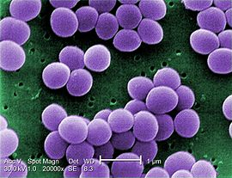
Gram + → Cocci → Anaerobic:
Peptostreptococcus species are commensal organisms in humans, living predominantly in the mouth, skin, gastrointestinal, vagina and urinary tracts, and compose a portion of the bacterial gut flora. Under immunosuppressed or traumatic conditions these organisms can become pathogenic, as well as septicemic, harming their host.
Gram + → Cocci → Aerobic:
Staphylococcus (+): clumps
Staphylococcus aureus (everywhere, including our flora and hospitals)
pimples and boils
pneumonia, meningitis, endocarditis, toxic shock syndrome (TSS)
Notes:
MERSA: Methicillin-resistant Staphylococcus aureus

Slide 3
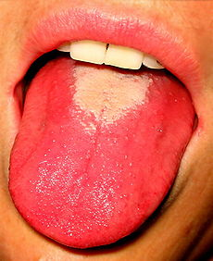
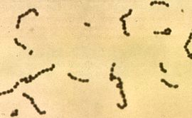
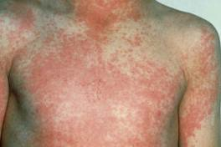
Streptococcal (+): chains
S. pneumoniae (sometimes called Pneumococcus), is a leading cause of bacterial pneumonia and occasional etiology of otitis media, sinusitis, meningitis and peritonitis.
S. pyogenes:
pharyngitis (strep throat)
Scarlet fever may lead to endocarditis
Streptococcus
Scarlet fever
Enterococci
Physical: difficult to distinguish from streptococci on physical characteristics alone.
From a medical standpoint, an important feature of this genus is the high level of intrinsic antibiotic resistance. Some enterococci are intrinsically resistant to β-lactam-based antibiotics (penicillins, cephalosporins, carbapenems), as well as many aminoglycosides.[4] In the last two decades, particularly virulent strains of Enterococcus that are resistant to vancomycin (vancomycin-resistant Enterococcus, or VRE) have emerged in nosocomial infections of hospitalized patients.
Enterococcus FaeciUM: streptogramins linezolid daptomycin
Enterococcus faecaLIS: linezolid daptomycin
Notes:
Linezolid or daptomycin are used to treat VRE infections. The streptogramins, such as quinupristin/dalfopristin, may also be used for vancomycin-resistant E. faecium, but not E. faecalis.
Vancomycin-resistant E. faecium is often referred to as VRE

Slide 4
Gram + → Bacilli → Anaerobic:
Lactobacillus: Convert lactose and other sugars to lactic acid.
Location: Vagina and GI flora
They are usually benign, except in the mouth where they have been associated with cavities
Used a probiotic and used to restore flora of vagina from Gardnerella vaginalis
Clostridium
C. Botulism: botox toxin in cosmetics and in honey so not good for infants (breathing muscles)
C. Difficile: GI flora. May flourish when antibiotics are used
C. tetani: tetanus (derived from the word tension)
Actinomyces: Actinomyces is normally present in the gingival area; in other words, it is considered comensal flora. It is the most common infection in dental procedures, oral abscess.
Gram + → Bacilli → Aerobic:
Lactobacillus
Corynebacterium: Corynebacterium diphtheriae
Listeria: Listeria monocytogenes is a foodborne pathogen
Gardnerella: Gardnerella vaginalis is a facultatively anaerobic Gram-variable rod that can cause bacterial vaginosis in some women as a result of a disruption in the normal vaginal microflora.

Slide 5
Gram Negative
Cocci
(sphere)
Bacilli
(rods)
Anaerobic
Aerobic
Rapid growth
organisms
Fastidious
organisms
Fermenters
Non fermenters
Neisseria gon
Moraxella
Bacteroides
Prevotella
Fusobacterium
E. Coli
Enterobacter
Salmonella
Shigella (Dysentery)
Klebsiella
Serratia
Citrobacter
Proteus
Pseudomonas
Acinetobacter
Stenotrophomonas
Burkholderia
HACEK
H: Haemophilus
A: Actinobacillus
C: Cardiobacterium
E: Eikenella
K: Kingella
Notes:
Fastidious organisms: organisms that live under specific conditions

Slide 6
Gram - → Cocci
Neisseria
N. Gonorrhoeae
N. Meningitidis (aka Meningococcus)
Moraxella
Moraxella catarrhalis: lower respiratory tract infection
Moraxella lacunata: one cause of pink eye
Gram - → Bacilli → Anaerobic
Bacteroides: Opportunistic during GI surgery (resistant to beta lactams, aminoglycosides and tetras)
Prevotella: vagina and oral flora. Recovered from infection of respiratory tract
Fusobacterium: common occurrence in Oropharynx
Gram - → Bacilli → Aerobic → Rapid Growth → Non-fermenters
Acinetobacter baumannii: Opportunistic. The illness can cause severe pneumonia and infections of the urinary tract, bloodstream and other parts of the body. One of the reasons is that the bacteria can live up to 5 months on undisturbed surfaces, depending on humidity levels.
Notes:
Bacteroides: opportunistic human pathogens, causing infections of the peritoneal cavity, gastrointestinal surgery, and appendicitis via abscess formation, inhibiting phagocytosis, and inactivating beta-lactam antibiotics.[9] Although Bacteroides species are anaerobic, they are aerotolerant and thus can survive in the abdominal cavity.
members of the oral and vaginal flora and are recovered from anaerobic infections of the respiratory tract

Slide 7
Pseudomonas aeruginosa (-)
An opportunistic, pathogen of immunocompromised individual
P. aeruginosa typically infects the pulmonary tract, urinary tract, burns
Infections | Details and common associations | High-risk groups
Skin infections | Hemorrhage and necrosis | Burns victims
Pneumonia | Diffuse bronchopneumonia | Cystic fibrosis patients
Septic shock | Associated with a purple-black skin lesion | Neutropenic patients (low neutrophils)
Gastrointestinal infection | Necrotizing enterocolitis (NEC) | premature infants
Gram - → Bacilli → aerobic → Fastidious organisms
Haemophilus Influenzae: lower respiratory tract infections in infants and children in developing countries where the vaccine is not widely used.

